Slide 1
Presentation On Strategies for Developing quality software
Sumitra Magar

Slide 2
What is software quality and quality assurance strategy?
The quality of software can be defined as the ability of the software to function as per user requirement. Software quality is defined as a field of study and practice that describes the desirable attributes of software products.
The quality assurance strategy is a combination of techniques and actions necessary to test the final version of the software in order to detect weak sides and prevent mistakes before the product is delivered to customers.

Slide 3
Strategies for Developing quality software
Who is QA analyst?
Quality assurance (QA) analyst is any systematic process of determining whether a product or service meets specified requirements. QA establishes and maintains set requirements for developing or manufacturing reliable products.
The Quality Assurance (QA) Analyst will Conduct testing on software, websites, and other technical products to identify and resolve bugs, defects, and other potential issues.

Slide 4
Strategies for Developing software
1. Software Development Methodologies
Software development methodology is a process or series of processes used in software development.
Some of the Software Development Methodologies are as follows:-
Waterfall system Development Model
Agile Development Methodology
Spiral Model
RAD
Prototyping Model

Slide 5
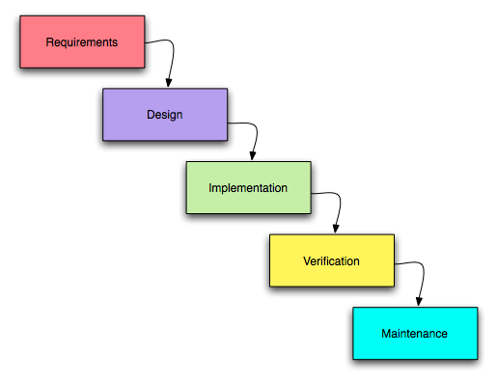
Waterfall system Development Model
The waterfall methodology is a linear project management approach, where stakeholder and customer requirements are gathered at the beginning of the project, and then a sequential project plan is created to accommodate those requirements.

Slide 6
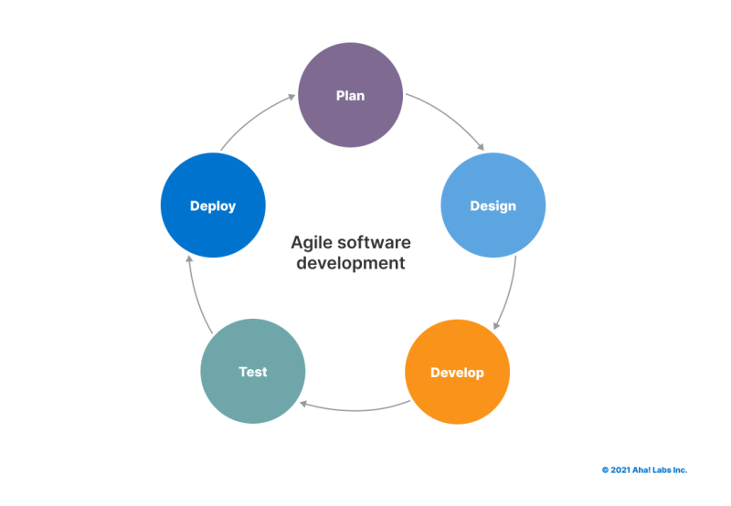
Agile Development Methodology
Agile is a software development methodology that focuses on flexibility, collaboration and efficiency that allow teams to deliver quality products.

Slide 7
Advantages of the Waterfall Model
Waterfall model is very simple and easy to understand and uses methodology. That is why it is beneficial for the beginner or novice developer.
It is easy to manage the projects because of the rigidity of the model. Moreover, each phase has specific deliverables and an individual review process.
Waterfall development methodology saves a significant amount of time at all the phases processed and completed at a given time.
The requirements are very well understood/defined in the waterfall method. Also, it works effectively for smaller projects.
You can easily do the testing that refers to the defined scenarios in the earlier functional specification.

Slide 8
Disadvantages of Waterfall Model
Waterfall method is not applicable to projects that demand continuous maintenance.
The main drawback of this method is that once an application is in the testing stage, it is not advisable to go back and do any amendments changes for completed software, it may cause a lot of problems.
There is no possibility that we can to develop any working software until it reaches the last stage of the cycle
You cannot include the client’s valuable feedback within the ongoing development phase.
In waterfall development method, there is no option to know the end result of the entire project
Make your requirements well-defined and clear or else this model is not suitable. It is effective for long and ongoing projects.
In waterfall methodology, Documentation occupies a lot of time for developers and testers.

Slide 9
Advantages of Agile Development Methodology
Customer satisfaction by rapid, continuous delivery of useful software.
Human interaction is emphasized rather than process and development tools. Customers, developers and testers constantly interact with each other.
Agile methodology has an adaptive approach that is able to respond to the changing requirements of the clients.
Direct communication and constant feedback from customer representatives leave no space for any guesswork in the system.

Slide 10
Disadvantages of Agile Development Methodology
In the case of some software deliverables, especially the large ones, it is difficult to assess the effort required at the beginning of the software development life cycle.
Agile focuses on working software rather than documentation, hence it may result in a lack of documentation.
The project can easily get taken off track if the customer representative is not clear what final outcome that they want.
Only senior programmers are capable of taking the kind of decisions required during the development process.

Slide 11
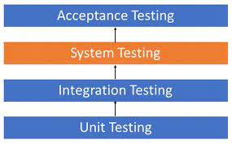
2. Software Quality Assurance
Software quality assurance (or SQA for short) is the ongoing process that ensures the software product meets and complies with the organization's established and standardized quality specifications.
Here, is the software testing Hierarchy:-

Slide 12
Software Quality Assurance
Unit Testing
Unit Testing is defined as a type of software testing where individual components of a software are tested.
2. Integration Testing
It is defined as a type of testing where software modules are integrated logically and tested as a group.
3. System Testing
It is a level of testing that validates the complete and fully integrated software product. The purpose of a system test is to evaluate the end-to-end system specifications.
4. Acceptance Testing
It is the last phase of software testing performed after System Testing and before making the system available for actual use.

Slide 13
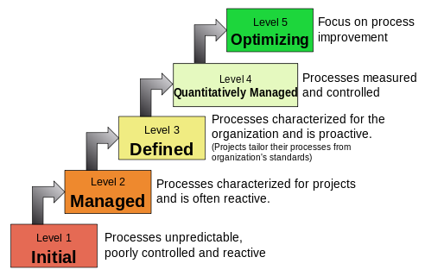
3. Capability Maturity Model Integration(CMMI)
The Capability Maturity Model Integration (CMMI) is a process and behavioral model that helps organizations streamline process improvement and encourage productive, efficient behaviors that decrease risks in software, product, and service development.
Phases of Capability Maturity Model integration(CCMI)

Slide 14
4. Risk Management procedures
Risk management is the process of identifying, assessing, and managing risks. It is performed in both planning and execution phases. An effective risk management strategy and application drastically reduces the chances of execution failures in software development.
The 4 essential steps of the Risk Management Process are:
Identify the risk.
The first step in the risk management process is to identify all the events that can negatively (risk) or positively (opportunity) affect the objectives of the software.
Assess the risk.
There are two types of risk and opportunity assessments: qualitative and quantitative.

Slide 15
Risk Management procedures
A qualitative assessment analyzes the level of criticality based on the event’s probability and impact.
A quantitative assessment analyzes the financial impact or benefit of the event. Both are necessary for a comprehensive evaluation of risks and opportunities.
Treat the risk.
In order to treat risks, an organization must first identify their strategies for doing so by developing a treatment plan. The objective of the risk treatment plan is to reduce the probability of occurrence of the risk (preventive action) and/or to reduce the impact of the risk (mitigation action).

Slide 16
Risk Management procedures
Monitor and Report on the risk.
Risks and opportunities and their treatment plans need to be monitored and reported on. The frequency of this will depend on the criticality of risk/opp. By developing a monitoring and reporting structure it will ensure there are appropriate forums for escalation and that appropriate risk responses are being actioned.

Slide 17
5. Quality Management Standards
A quality management system (QMS) is defined as a formalized system that documents processes, procedures, and responsibilities for achieving quality policies and objectives.
It aims to develop and manage the quality of software in such a way so as to best ensure that the product meets the quality standards expected by the customer while also meeting any necessary regulatory and developer requirements.
It ensure the required level of quality is achieved in a software product.

Slide 18
6. Failure Mode and Effect Analysis
Failure Modes and Effects Analysis (FMEA) is a systematic, proactive method for evaluating a process to identify where and how it might fail and to assess the relative impact of different failures, in order to identify the parts of the process that are most in need of change.
It is a structured approach to discovering potential failures that may exist within the design of a product or process.
Failure modes are the ways in which a process can fail.
Effects are the ways that these failures can lead to waste, defects or harmful outcomes for the customer.
The steps that should be conducted with the highest priority are as follows:
Determine the severity rating:
Determine the occurrence rating:
Determine the critically:
Determine the detection rating:
Calculate the risk priority rating:

Slide 19
Failure Mode and Effect Analysis
The situation where conducting a Failure Mode and Effect Analysis makes sense.
When creating a fresh product , process and service
When you intend to carry out an existing process in novel manner
When you want to improve the quality of the particular process
When you need to comprehend and fix a process’s flaws
When there are periodic checks during the life of a product, service or process.

Slide 20


